Slide 1






Commodity
Machine Learning
and beyond
amueller@nyu.edu
@amuellerml
@amueller
Amueller.io
Andreas Müller
NYU, scikit-learn

Slide 2

To Apply Machine Learning!

Slide 3
What ML can do for you

Slide 4
Hi Andy,
I just received an email from the first tutorial speaker, presenting right before you, saying he's ill and won't be able to make it.
I know you have already committed yourself to two presentations, but is there anyway you could increase your tutorial time slot, maybe just offer time to try out what you've taught? Otherwise I have to do some kind of modern dance interpretation of Python in data :-)
-Leah
Classification
Hi Andreas,
I am very interested in your Machine Learning background. I work for X Recruiting who have been engaged by Z, a worldwide leading supplier of Y. We are expanding the core engineering team and we are looking for really passionate engineers who want to create their own story and help millions of people.
Can we find a time for a call to chat for a few minutes about this?
Thanks

Slide 5
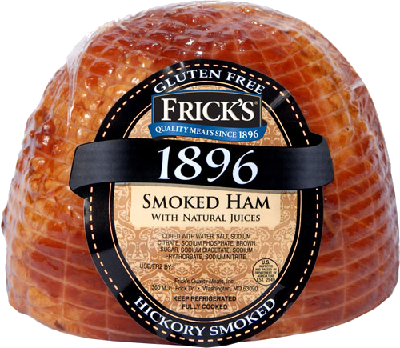
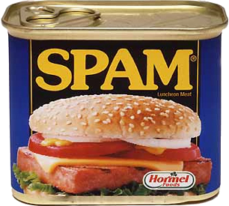
Hi Andy,
I just received an email from the first tutorial speaker, presenting right before you, saying he's ill and won't be able to make it.
I know you have already committed yourself to two presentations, but is there anyway you could increase your tutorial time slot, maybe just offer time to try out what you've taught? Otherwise I have to do some kind of modern dance interpretation of Python in data :-)
-Leah
Classification
Hi Andreas,
I am very interested in your Machine Learning background. I work for X Recruiting who have been engaged by Z, a worldwide leading supplier of Y. We are expanding the core engineering team and we are looking for really passionate engineers who want to create their own story and help millions of people.
Can we find a time for a call to chat for a few minutes about this?
Thanks

Slide 6
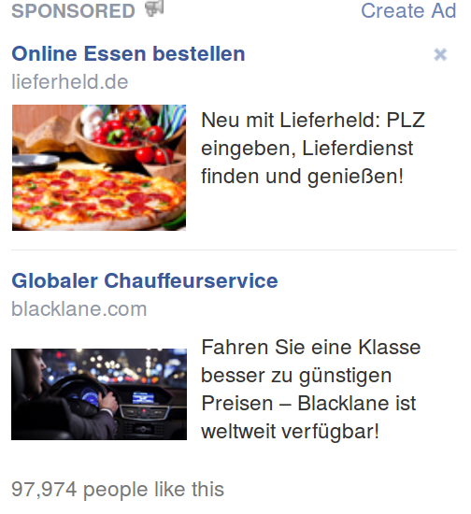
Classification

Slide 7
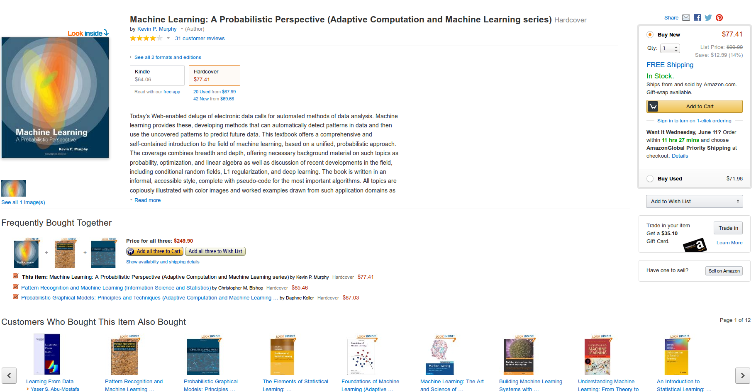
Recommendations

Slide 8
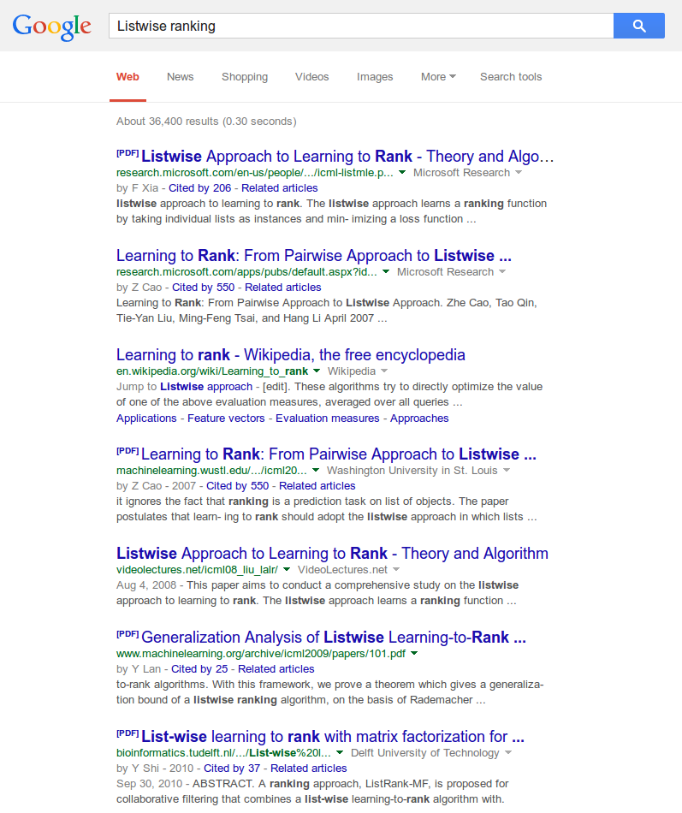
Ranking

Slide 9
Applying machine learning is easy.

Slide 10
Applying machine learning is easy.
But it should be easier!

Slide 11




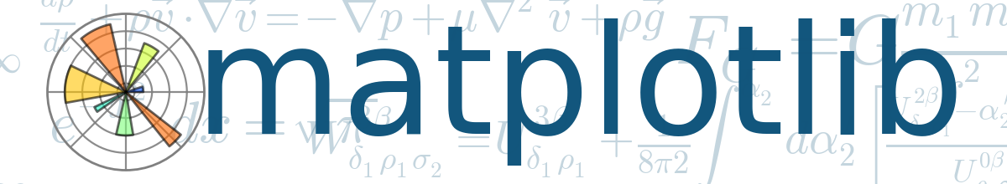


Slide 12
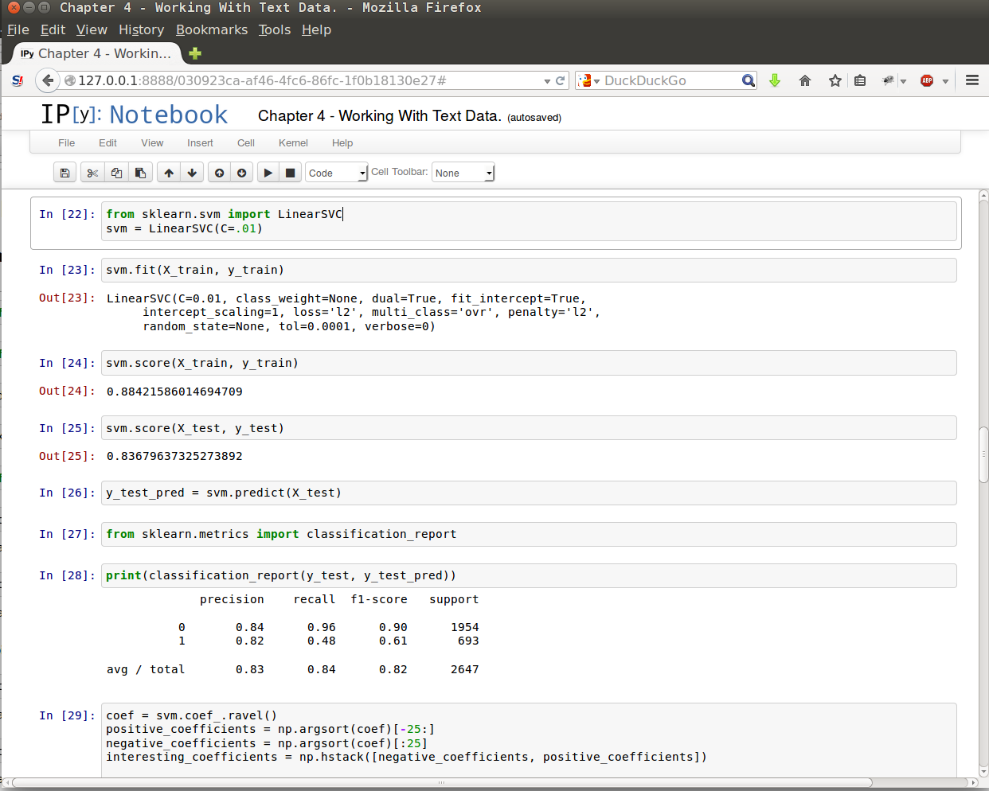
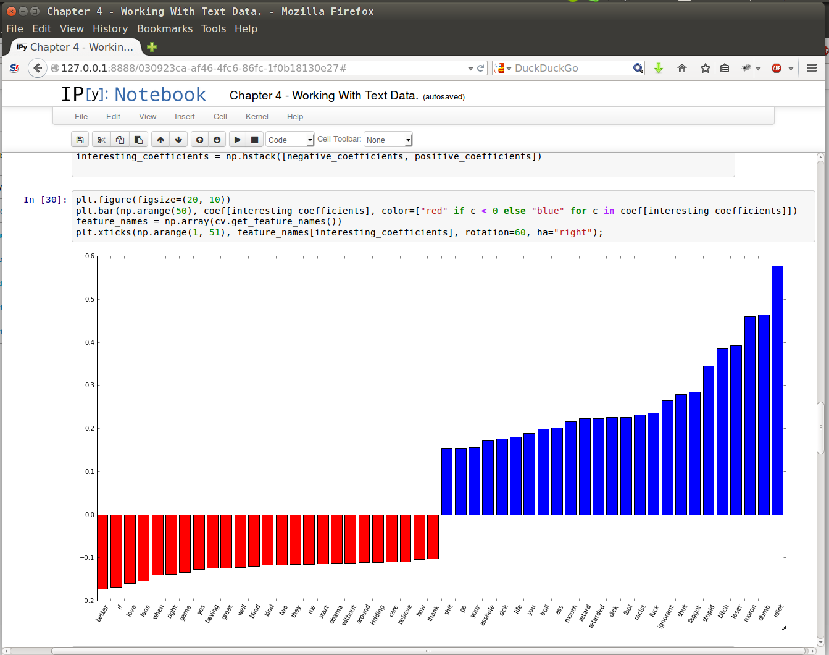

Slide 13
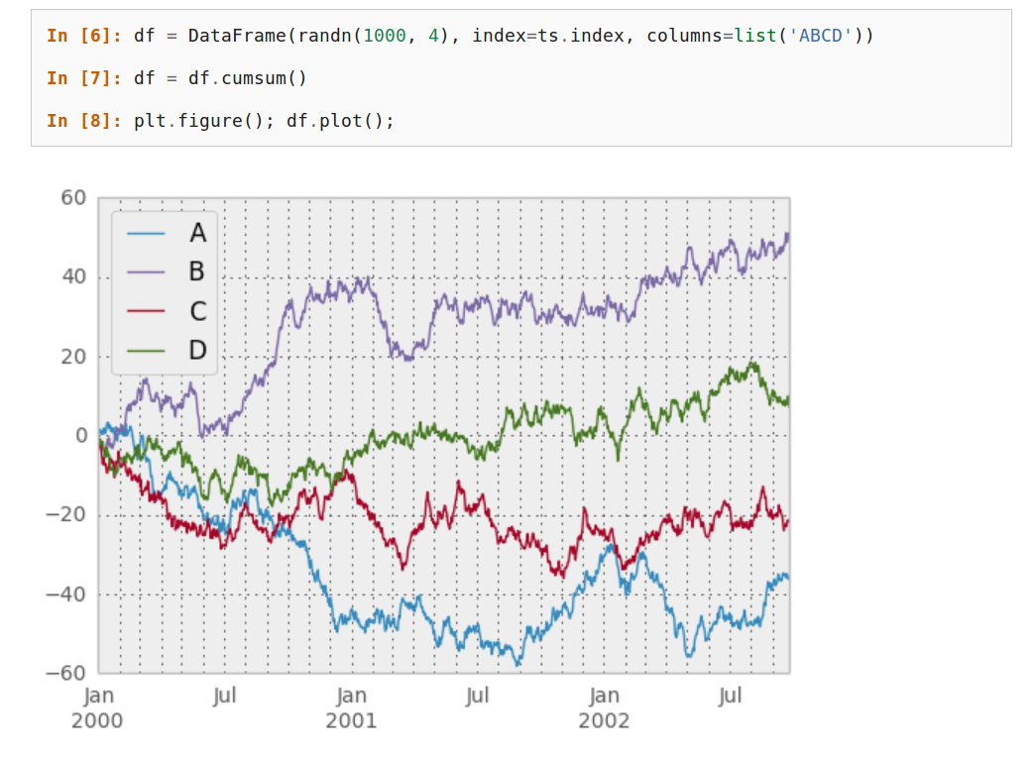

Slide 14
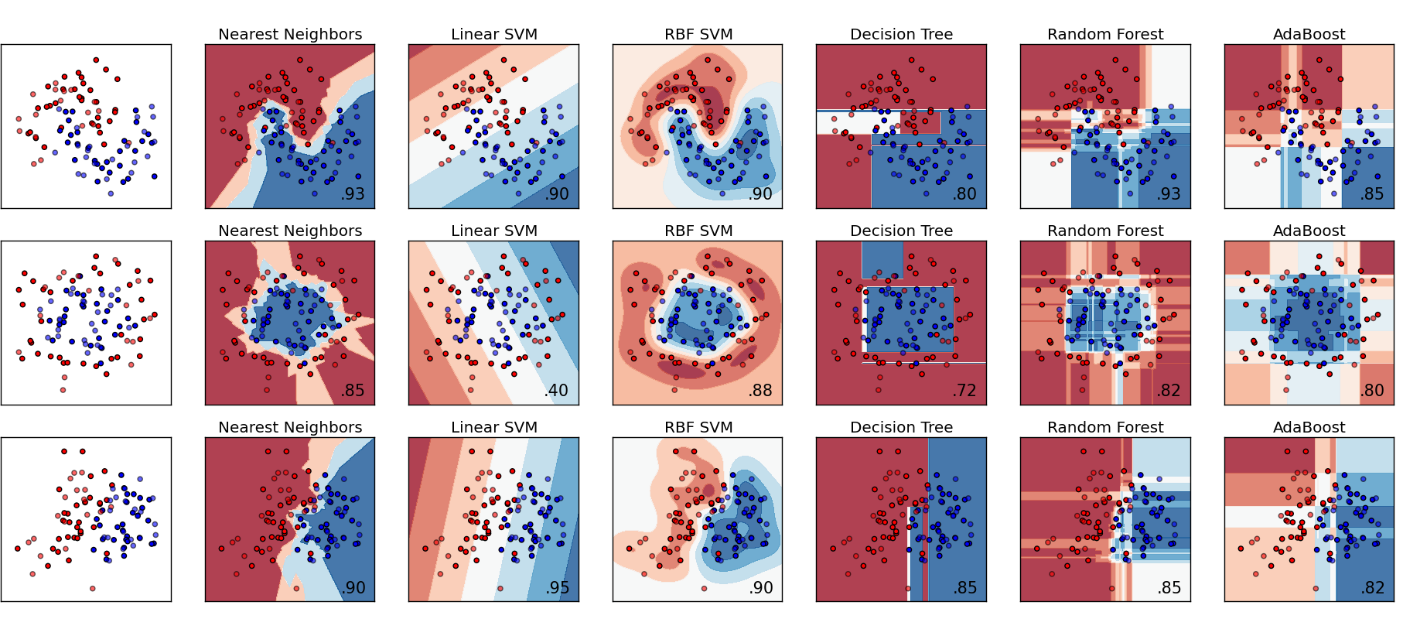

Slide 15








2750+ research papers

Slide 16
Fully Functional Spam Classifier
from sklearn.naive_bayes import MultinomialNB
from sklearn.feature_extraction.text import CountVectorizer
from pipeline import make_pipeline
spam_classifier = make_pipeline(CountVectorizer(),
MultinomialNB())
spam_classifier.fit(email_texts, is_spam)
spam_classifier.predict(new_emails)

Slide 17
“The scikit-learn tutorials / documentation is so good, one doesn't need a textbook anymore to learn a new machine learning method.”

Slide 18
This is not enough!

Slide 19
Automation /
Expertise needed
Data size

Slide 20
Automation /
Expertise needed
One Click
Library
Data size
Fits in Ram
Single Machine
Infinitely scalable

Slide 21


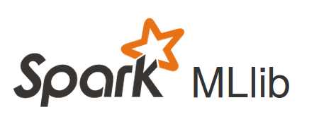
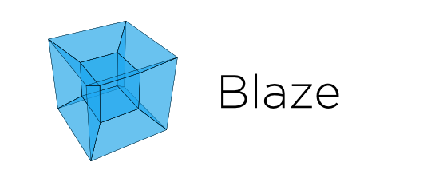
Automation /
Expertise needed
One Click
Skll
Azure ML
Amazon Machine Learning
Library
Data size
Fits in Ram
Single Machine
Infinitely scalable

Slide 22
Why a single machine is (usually) enough

Slide 23
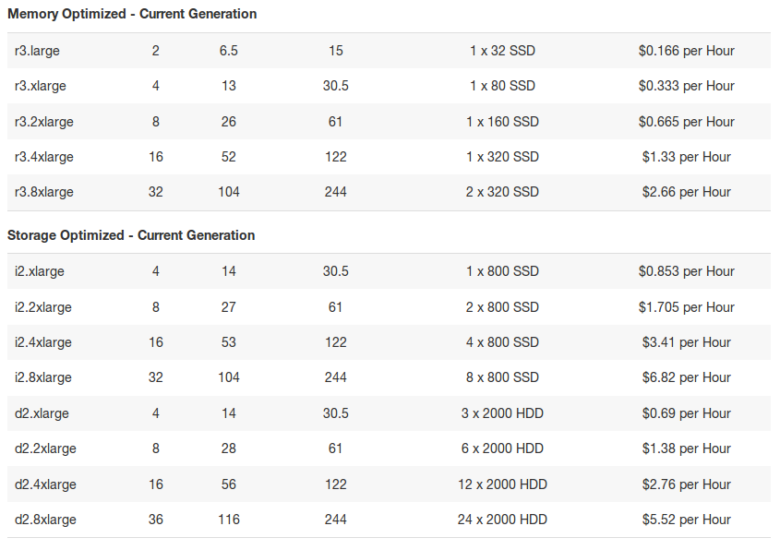

Slide 24
We need open box methods.

Slide 25
We need black-box methods.

Slide 26

predict

Slide 27
Hyperparameter Optimization
Spearmint
Hyperopt
SMAC
… scikit-learn

Slide 28
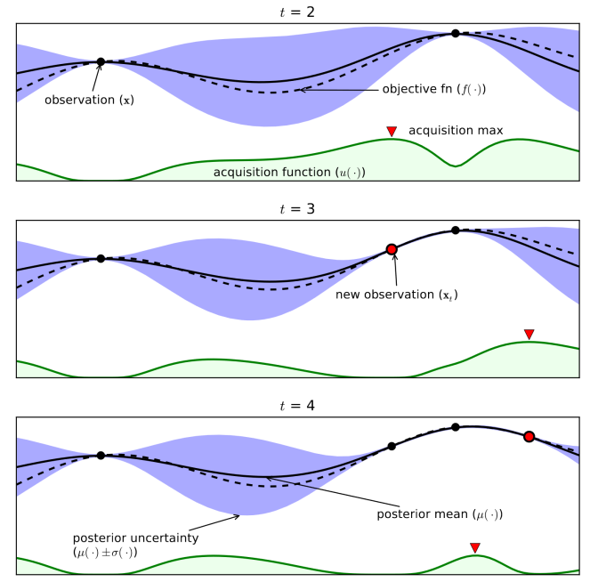
Bayesian Optimization
From Eric Brochu, Vlad M. Cora and Nando de Freitas

Slide 29
Meta-Learning
Dataset 1
Algorithm + Parameters
optimization
Meta-Features 1
Dataset 2
Algorithm + Parameters
ML model
optimization
Meta-Features 2
Dataset 3
Algorithm + Parameters
optimization
Meta-Features 3
New Dataset
ML model
Algorithm + Parameters

Slide 30
Automation /
Expertise needed
One Click
Skll
Azure ML
Library
Data size
Fits in Ram
Single Machine
Infinitely scalable

Slide 31



Automation /
Expertise needed
One Click
Skll
Azure ML
Library
Data size
Fits in Ram
Single Machine
Infinitely scalable

Slide 32
Automation /
Expertise needed
One Click
Next Stop
Skll
Azure ML
Library
Data size
Fits in Ram
Single Machine
Infinitely scalable

Slide 33

Release June 2016

Slide 34

Thank you.
@amuellerml
@amueller
amueller@nyu.edu
http://amueller.io

